Slide 1
Unveiling the Virtual Classroom: An In-depth Analysis of the Online Education System
Ram Prasad Reddy Sadi

Slide 2
Problem Understanding
This project aims to delve deep into the various aspects of online education, examining its strengths, weaknesses, opportunities, and challenges.
The outcomes of this project will provide valuable insights for educational institutions, policymakers, and online learning platforms to enhance the effectiveness and accessibility of online education.
This analysis of the online education system aims to contribute to the ongoing dialogue on the future of education and help shape a more inclusive, engaging, and effective learning environment in the digital age.

Slide 3
Business Requirements
The project requires student and teacher surveys, understanding student needs, and having an efficient feedback system.
There is a need to update the content that is being taught to students based on the feedback.
These requirements are necessary to ensure that students are able to find it easy to adjust with online education / e-learning.
The requirements vary bases on the geographic location of the students.

Slide 4
Business Requirements
Some of the key business requirements include :
Clear Educational Objectives
Content Development and Quality Assurance
Technology Infrastructure
User-Friendly Interface and User Experience
Data Analytics and Reporting
Compliance and Accreditation
Scalability and Future Growth
Feedback and Continuous Improvement
Accessibility and Inclusivity
Feedback and Review Mechanisms

Slide 5
Literature Survey
Allen, I. E., & Seaman, J. (2017). Grade Increase: Tracking Distance Education in the United States.
Means, B., Toyama, Y., Murphy, R., Bakia, M., & Jones, K. (2009). Evaluation of evidence-based practices in online learning: A meta-analysis and review of online learning studies.
Anderson, T. (2003). Getting the mix right again: An updated and theoretical rationale for interaction.
Lee, Y.-H., Hsieh, Y.-C., & Hsu, C.-N. (2014). Adding innovation diffusion theory to the technology acceptance model: Supporting employees’ intentions to use e-learning systems.
Hodges, C., Moore, S., Lockee, B., Trust, T., & Bond, A. (2020). The difference between emergency remote teaching and online learning.
DiMaggio, P., Hargittai, E., Neuman, W. R., & Robinson, J. P. (2001). Social implications of the Internet.
Garrison, D. R., & Kanuka, H. (2004). Blended learning: Uncovering its transformative potential in higher education.
Bergmann, J., & Sams, A. (2012). Flip your classroom: Reach every student in every class every day.

Slide 6
Social or Business Impact
Pros of E-Learning:
Accessibility: E-learning breaks down geographical barriers, making education accessible to individuals regardless of their location. This inclusivity is particularly beneficial for students in remote areas or those with physical disabilities.
Flexibility: E-learning offers flexibility in terms of scheduling and pacing. Learners can access materials at their convenience, allowing them to balance education with work, family, or other commitments.
Cost-Effective: Online courses often cost less than traditional in-person education, as there are no expenses for commuting, housing, or physical classroom facilities.
Personalization: E-learning platforms can tailor content to individual learning styles and pace, potentially leading to more effective learning experiences.
Global Learning Communities: E-learners have the opportunity to connect with peers and instructors from around the world, fostering diverse and inclusive learning environments.

Slide 7
Social or Business Impact
Cons of E-Learning:
Digital Divide: Not all learners have access to the necessary technology and internet connectivity, exacerbating existing inequalities in education.
Lack of Social Interaction: E-learning can be isolating, as it often lacks the face-to-face interaction found in traditional classrooms. This may lead to feelings of loneliness and decreased motivation.
Self-Motivation: E-learning requires a higher level of self-discipline and motivation. Some students may struggle with time management and staying engaged.
Quality Assurance: Ensuring the quality of online courses can be challenging. There is a risk of subpar content and inadequate assessment methods.
Limited Practical Experience: Some fields, such as hands-on sciences or trades, require practical, hands-on experience that e-learning cannot fully replicate.

Slide 8
Social or Business Impact
Improving E-Learning for Future Generations
Address the Digital Divide
Enhance Social Interaction
Support and Quality Control
Blended Learning
Lifelong Learning
Feedback and Assessment
Cultural Sensitivity
Research and Innovation
Mental Health Support

Slide 9
Data
The dataset contains the following attributes with 1033 instances.
Gender: Gender of the student
Home Location: Rural or Urban.
Level of Education : UG, PG or school
Age : age of the student
Number of subjects :
Device Type Used : device used to attend the online classes
Economic status : economic status of the family
Internet facility in your locality
Are you involved on any sports
Family Size
Do elderly people monitor you ?.
Study Time(hours)
Sleep time (hours)
Time spent on social media(hours)
Interested in gaming ?
Have a separate room for studying ?
Engaged in group studies ?
Average marks scored before pandemic in traditional classroom
Your interaction in online mode
Clearing doubts with faculties online ?
Interested in ?
Performance in online
Your level of satisfaction in online education

Slide 10
Data Preparation
Upload the dataset into cognos and cleanse the data as necessary
Data can be preprocessed using the “Data module” option in cognos

Slide 11
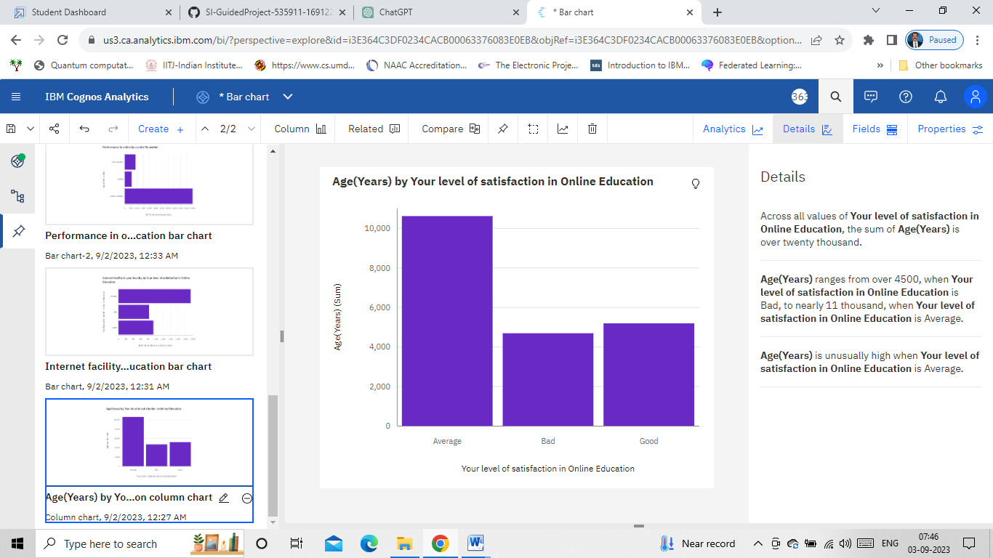
Data Visualizations
Column chart: Age(Years) by Your level of satisfaction in Online Education

Slide 12
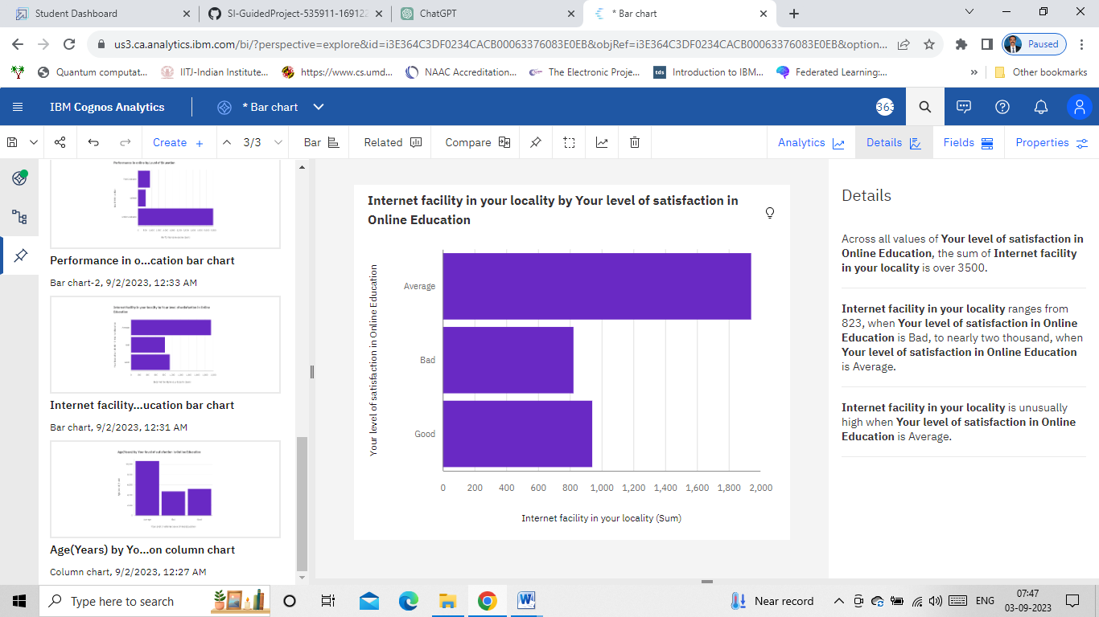
Data Visualizations
Bar chart: Internet facility in your locality by Your level of satisfaction in Online Education

Slide 13
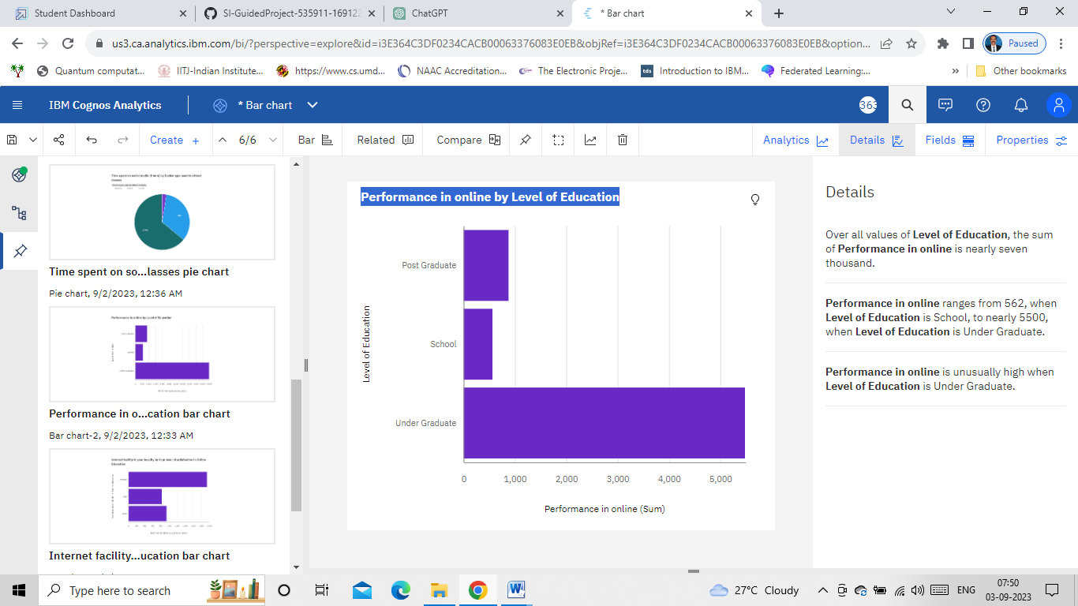
Data Visualizations
Bar chart: Performance in online by Level of Education

Slide 14
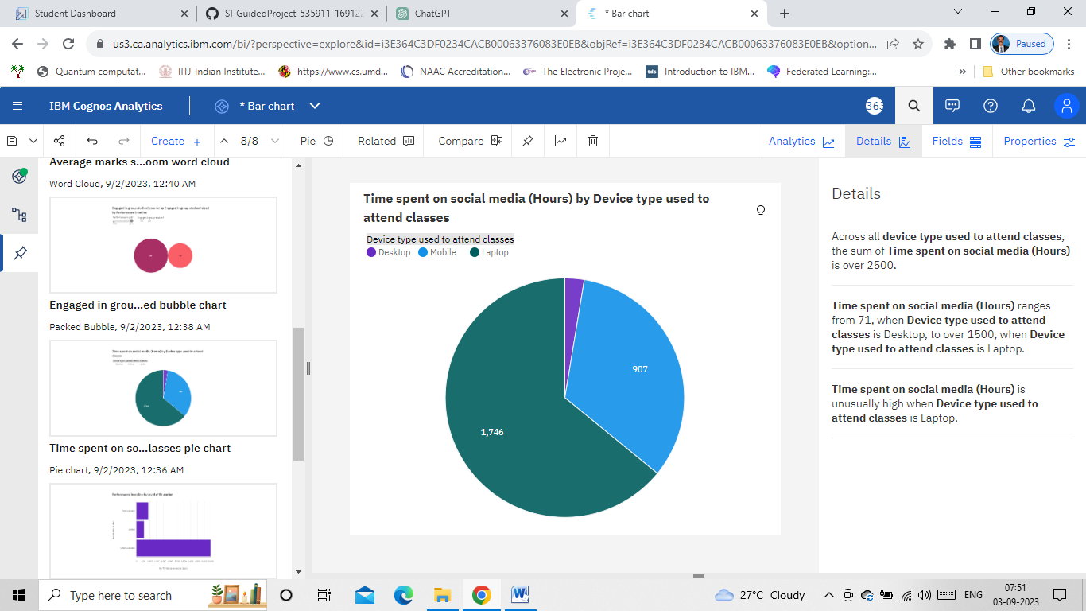
Data Visualizations
Pie chart: Time spent on social media (Hours) by Device type used to attend classes

Slide 15
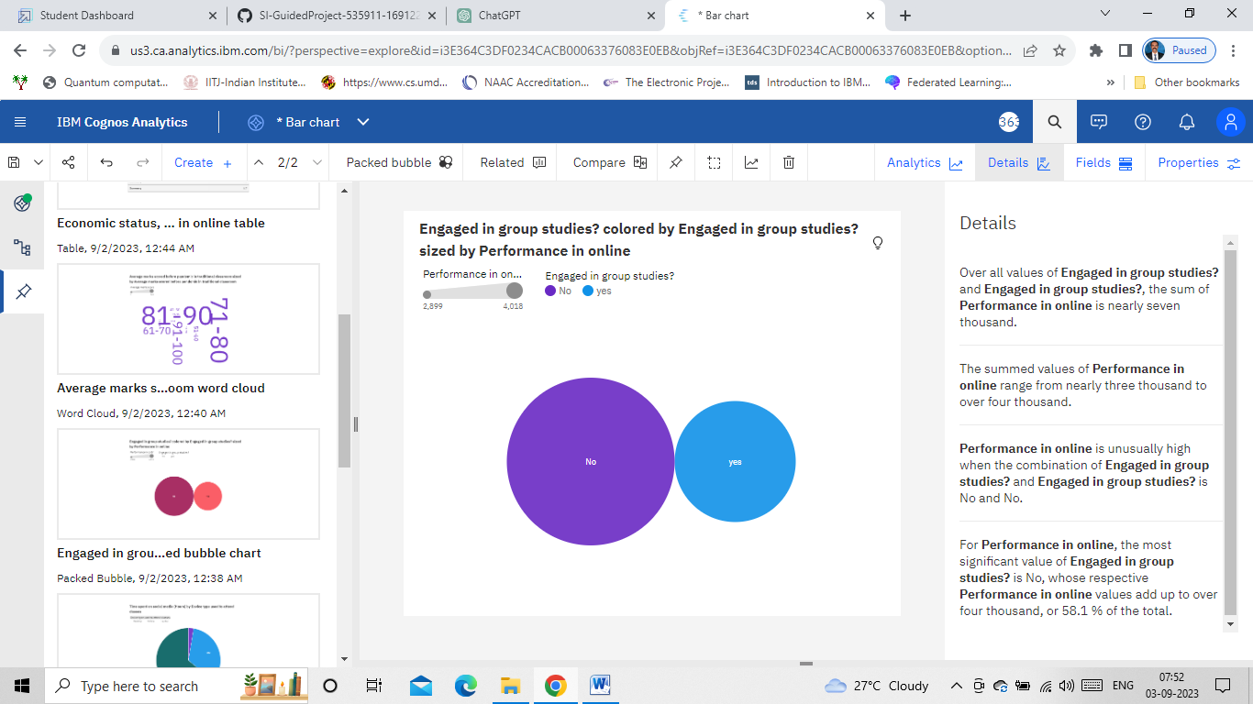
Data Visualizations
Packed Bubble: Engaged in group studies? colored by Engaged in group studies? sized by Performance in online

Slide 16
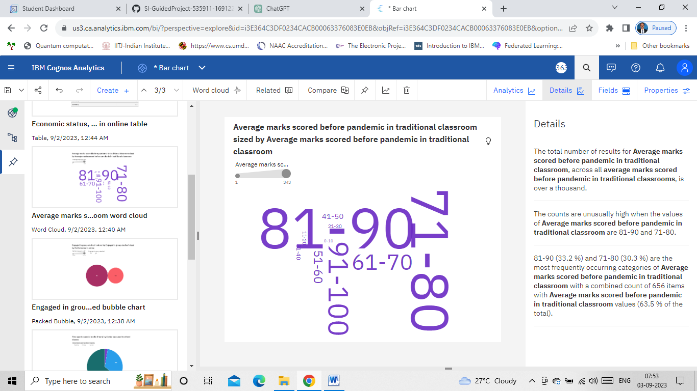
Data Visualizations
Word Cloud: Average marks scored before pandemic in traditional classroom sized by Average marks scored before pandemic in traditional classroom

Slide 17
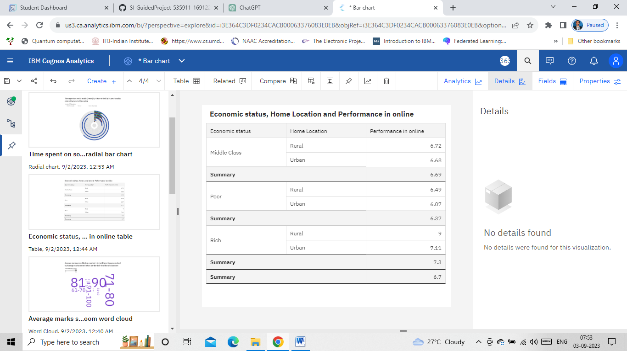
Data Visualizations
Table: Economic status, Home Location and Performance in online

Slide 18
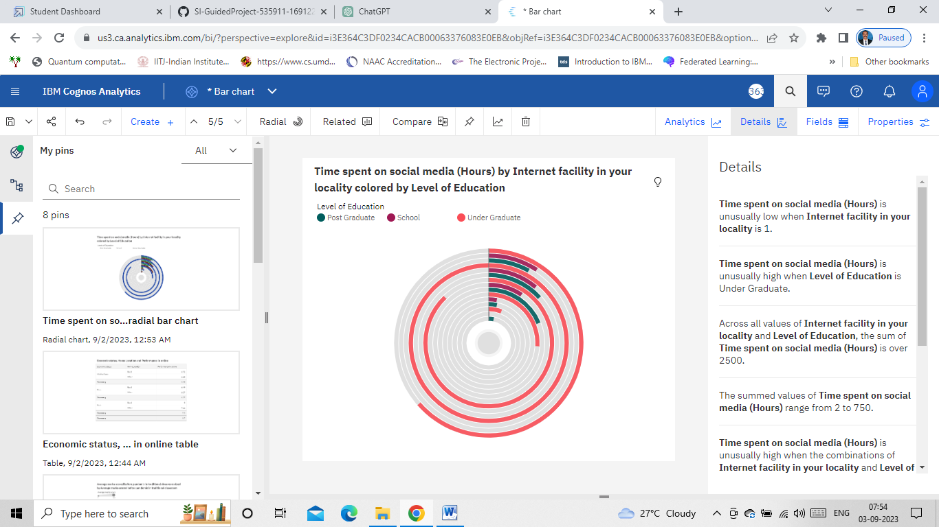
Data Visualizations
Radial Bar: Time spent on social media (Hours) by Internet facility in your locality colored by Level of Education

Slide 19
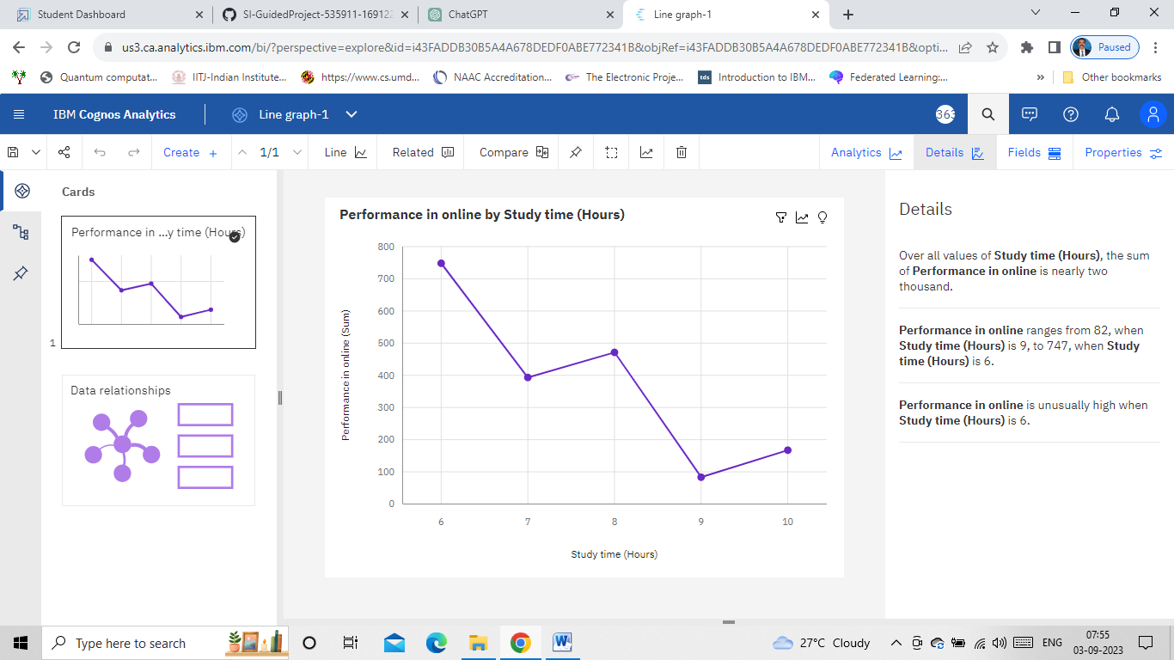
Data Visualizations
Line Graph: Performance in online by Study time (Hours)

Slide 20
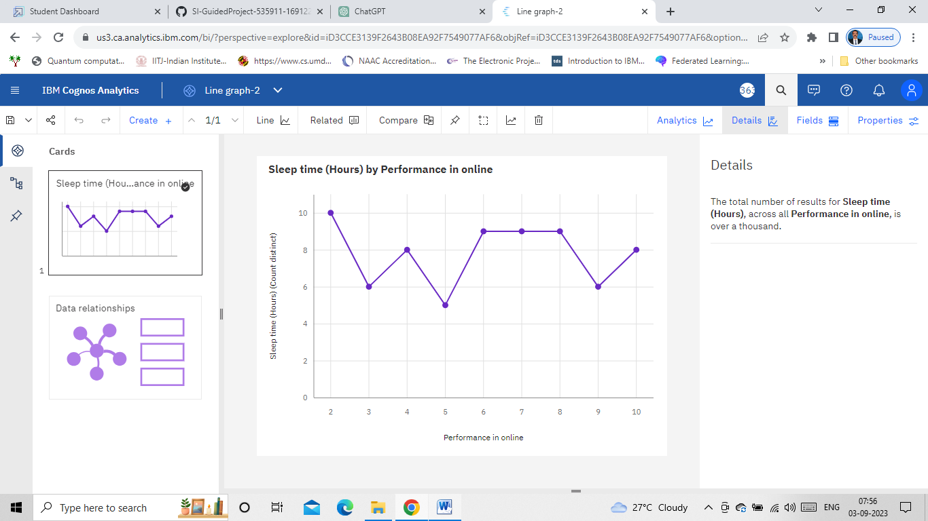
Data Visualizations
Line Graph: Sleep time (Hours) by Performance in online

Slide 21
Dashboard
A dashboard is a graphical user interface (GUI) that displays information and data in an organized, easy-to-read format.
Dashboards are often used to provide real-time monitoring and analysis of data, and are typically designed for a specific purpose or use case.
Dashboards can be used in a variety of settings, such as business, finance, manufacturing, healthcare, and many other industries.
They can be used to track key performance indicators (KPIs), monitor performance metrics, and display data in the form of charts, graphs, and tables.

Slide 22
Dashboard
A dashboard is a graphical user interface (GUI) that displays information and data in an organized, easy-to-read format.
Dashboards are often used to provide real-time monitoring and analysis of data, and are typically designed for a specific purpose or use case.
Dashboards can be used in a variety of settings, such as business, finance, manufacturing, healthcare, and many other industries.
They can be used to track key performance indicators (KPIs), monitor performance metrics, and display data in the form of charts, graphs, and tables.

Slide 23
Story
A data story is a way of presenting data and analysis in a narrative format, with the goal of making the information more engaging and easier to understand.
A data story typically includes a clear introduction that sets the stage and explains the context for the data, a body that presents the data and analysis in a logical and systematic way, and a conclusion that summarizes the key findings and highlights their implications.
Data stories can be told using a variety of mediums, such as reports, presentations, interactive visualizations, and videos.

Slide 24
Report
A report is a document that presents information in a specific format and layout, usually based on data from a database or other data source.
A report in IBM Cognos can contain various elements, such as tables, charts, graphs, and images, as well as text and data elements, and it is designed to be used by business users to help them better understand their data and make informed decisions.
There are several different types of reports available in IBM Cognos, including list reports, crosstab reports, chart reports, and report studio reports, among others.
The type of report that you choose will depend on the specific needs and requirements of your organization, as well as the data that you need to present

Slide 25
Performance Testing
Performance testing is a non-functional software testing technique that determines how the stability, speed, scalability, and responsiveness of an application holds up under a given workload.
Amount of Data Rendered to DB
The data mounted consists of 1033 instances with 23 attributes.

Slide 26
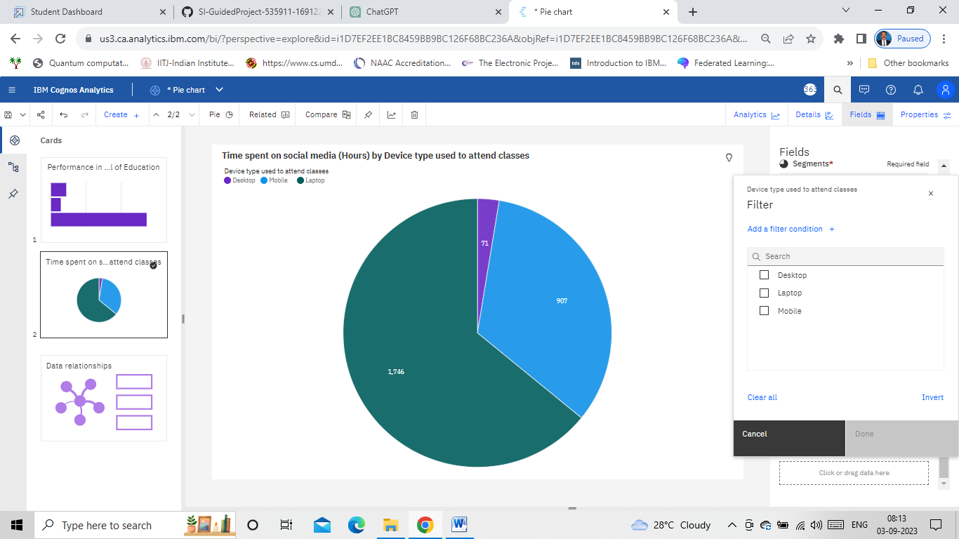
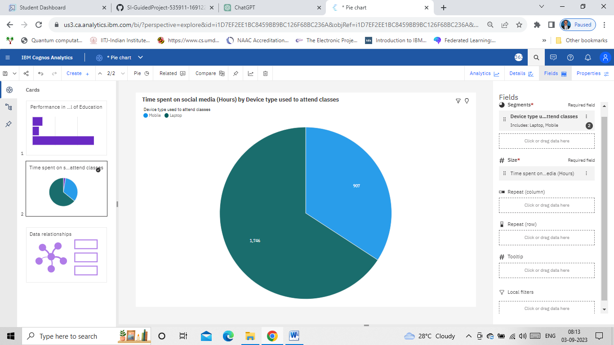
Performance Testing
Utilization of Data Filters
Data filters are used to customize our visualization to achieve desired output
We can apply filters while building visualizations .
In explorations, filters are present at bottom of the ‘Fields’ option
Before applying the filter
After applying the filter

Slide 27
Performance Testing
Utilization of Data Filters
Data filters are used to customize our visualization to achieve desired output
We can apply filters while building visualizations .
In explorations, filters are present at bottom of the ‘Fields’ option
Before applying the filter
After applying the filter

Slide 28
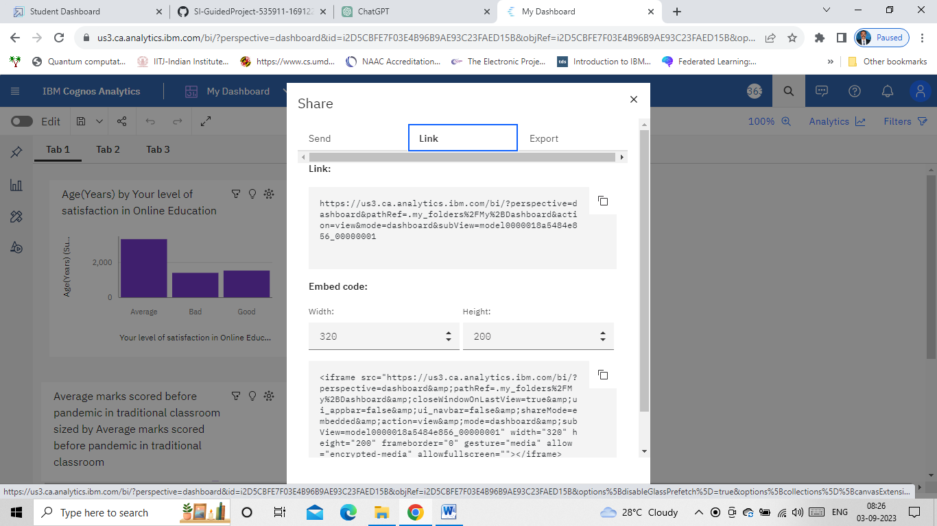
Web Integration
Publishing helps us to track and monitor key performance metrics, to communicate results and progress, help a publisher stay informed, make better decisions, and communicate their performance to others.
Copy the “Embed code” by clicking on the “share” option in dashboard or story or report as shown in the following figure.

Slide 29
Web Integration
To embed the story, dashboard and the report with UI with Flask, the following steps are followed:
Step-1: Download the free online Bootstrap templates that suits our requirement
Step-2: Install Visual Studio Code
Step-3: Open the “index.html” file in visual studio code
Step-4: Locate “about”, “portfolio” and “services” and remove the content present between the tags “div”. Insert the corresponding the content copied from the cognos share option of dashboard, story, and report respectively. Modify the width and height to 1100 and 1000 respectively.

Slide 30
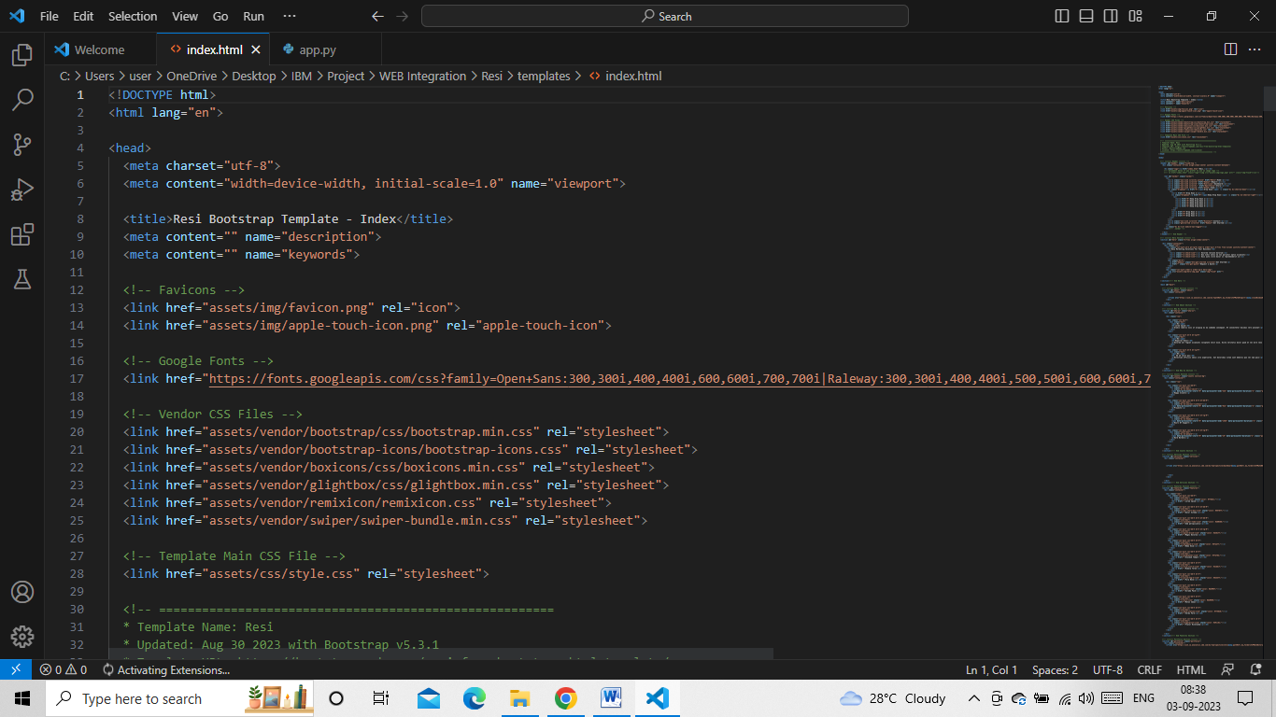
Web Integration

Slide 31
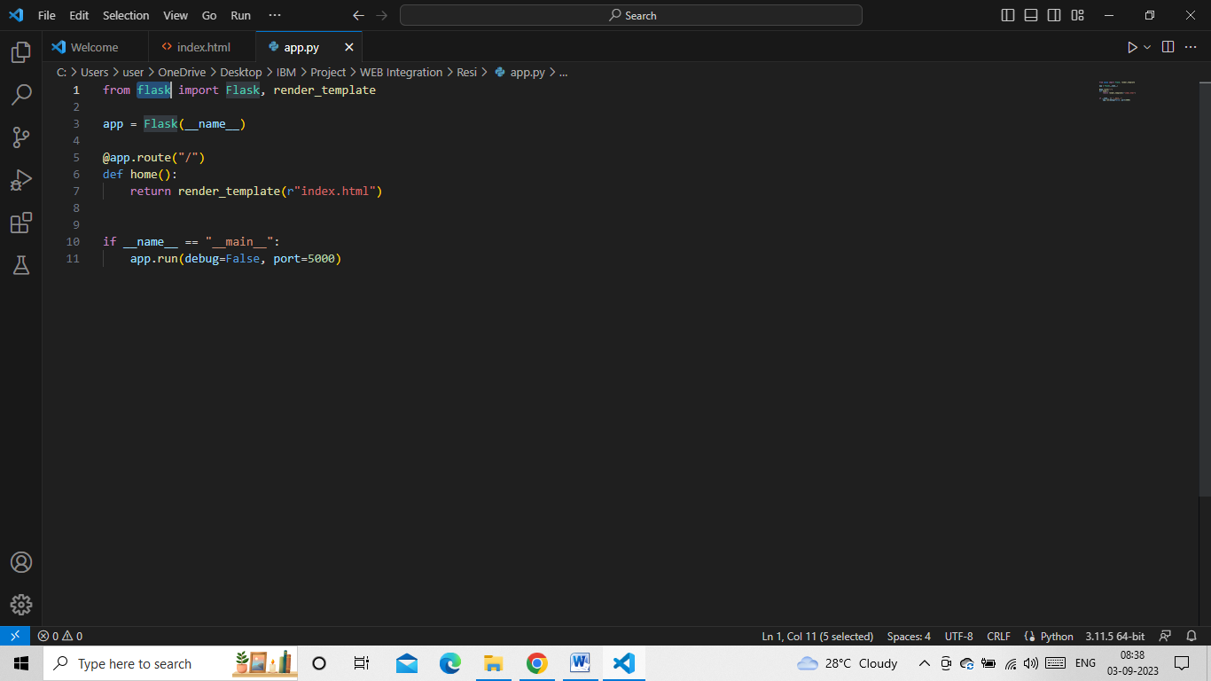
Web Integration
Step-5: Install “Flask” using pip install flask
Step-6: Create the “app.py” file as follows in visual studio code
from flask import Flask, render_template
app = Flask(__name__)
@app.route("/")
def home():
return render_template(r"index.html")
if __name__ == "__main__":
app.run(debug=False, port=5000)

Slide 32
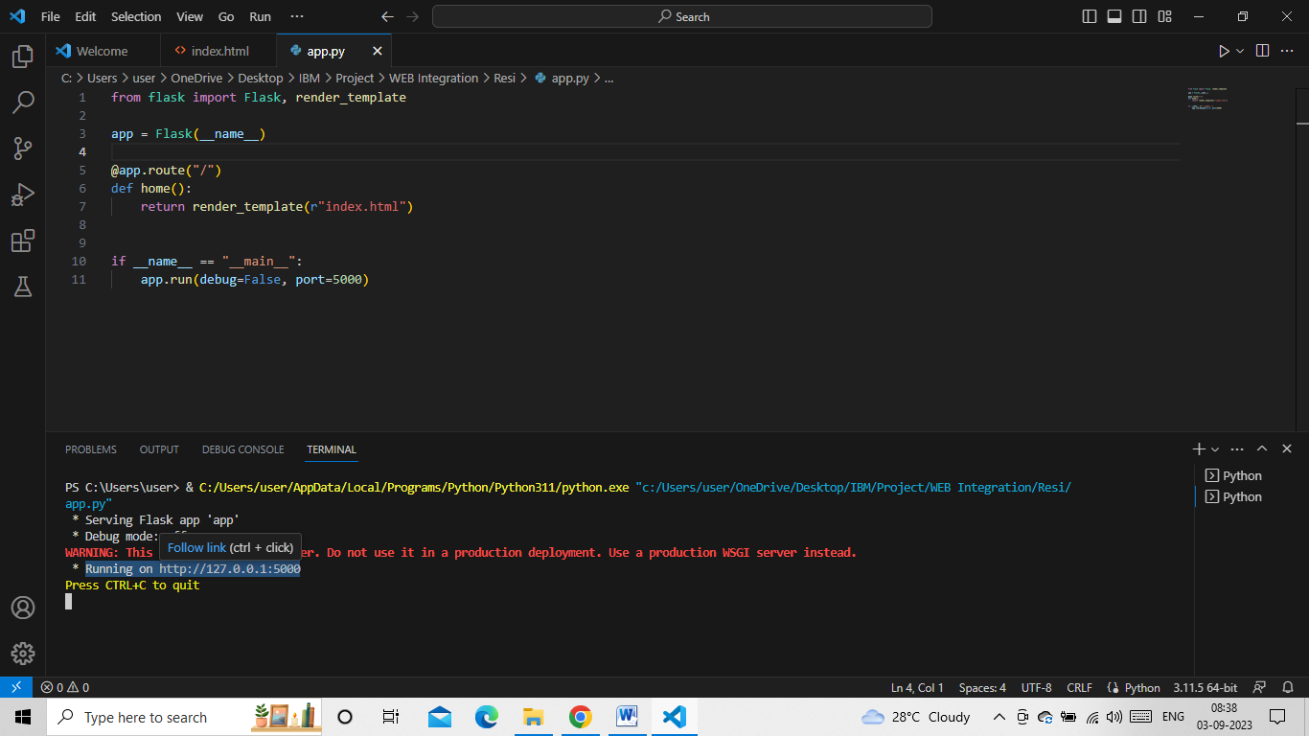
Web Integration
Step-7: Run the python file which the provides the following address

Slide 33
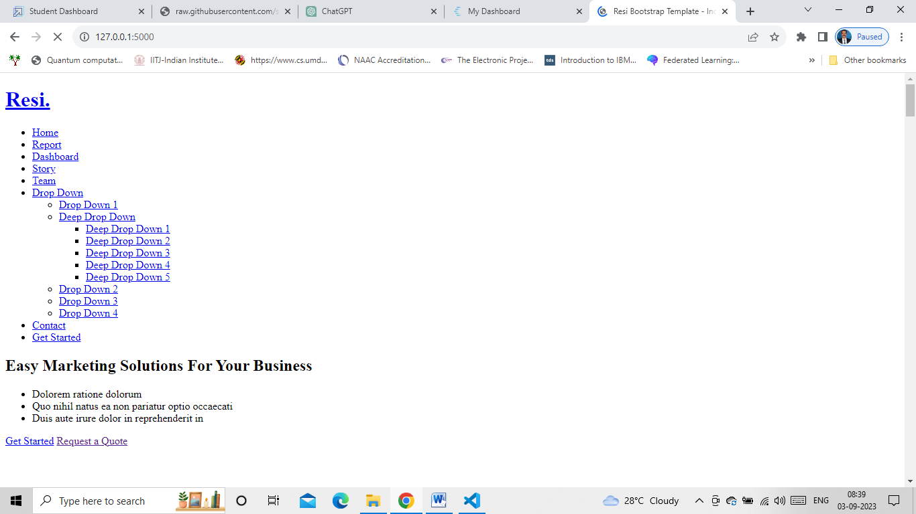
Web Integration
Step-8: Copy the address: http://127.0.0.1:5000 and paste it in address bar and run

